Slide 1
Hyperparameter Tuning in Privacy-Preserving Machine Learning
Hlib Kokin

Slide 2
Dataset
Heart disease dataset of 2022 without NaN values
246 000 rows with 39 columns, 1 target column – “Heart disease”
Splitted by coef 74:26, which makes it 180 000 : 66 000

Slide 3
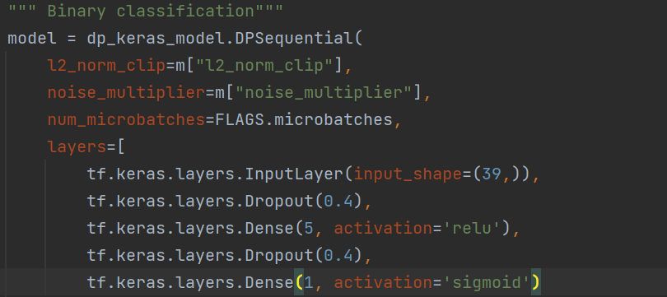
Differentially Private Model
Binary Classification model with DP
Batch size is 50 and microbatches are 25 to adjust speed of training for optimal of 6 epochs

Slide 4
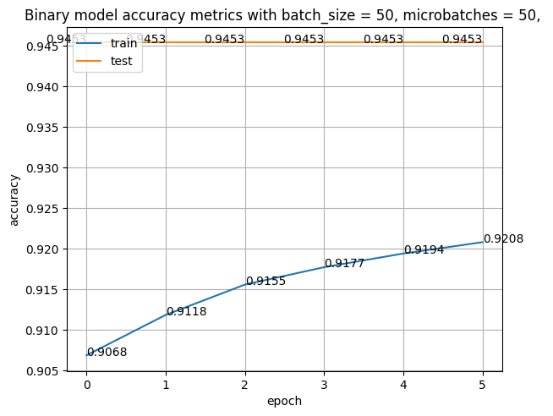
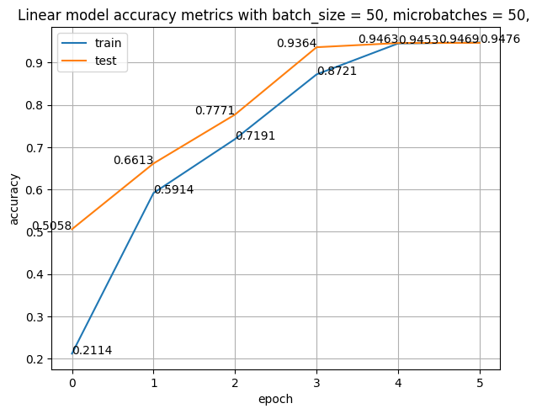
Baseline Models
As baseline models we have:
Binary Classification model without dp (same layers as in model with dp)
Linear Regression

Slide 5
Static hyperparameters
Learning rate is 0.0001 to not overtrain model to early
Epochs = 6, optimal by speed and accuracy to compare training with dynamic hyperparameters

Slide 6

Grid Search hyperparameters
L2_norm_clip - a privacy guard, making sure no one data point can throw the whole model off balance. It's like saying, "Everyone gets a fair say, but no one gets to shout too loudly.“ (default = 1)
noise_multiplier – How much noise do we want to add to our data (more noise increases chances of training a non accurate model) (default = 1)
Using next coefficients to multiply our default l2_norm_clip and noise multiplier will in result give us a wide range of hyperparameters containing and lower bound, and upper bound

Slide 7
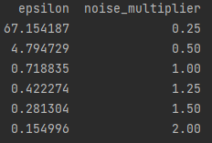
Epsilon values
Noise_multiplier has impact on epsilon, l2_norm_clip makes difference only on the accuracy of the model

